Slide 1
The effect of High-Speed Railway on Local GDP, DID method
Shuhang Lou
04/25/2023

Slide 2
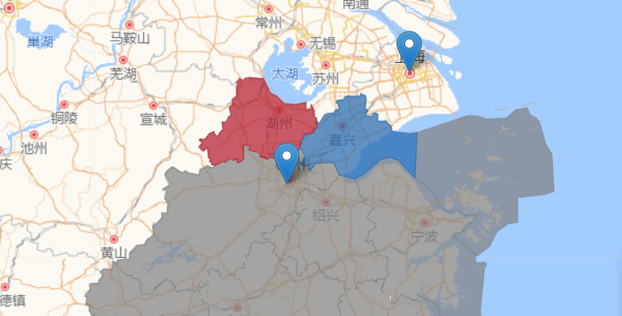
background
The shaded areas are Jiaxing City for blue and Huzhou City for red. Pin above is Shnaghai for studying city overall and pin below is Hangzhou for studying suburban areas.
These two cities were used to be a Special Administrative Region of Zhejiang Province before 1983 and later split into two cities.
Both located in the northern part of Zhejiang Province, approximately 150 kilometers away from Shanghai, and 100 kilometers away from Hangzhou.

Slide 3
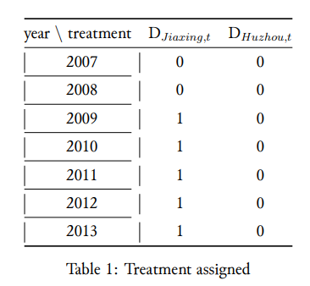
Set up and analysis
Yit, is the observed annual GDP of city/suburban i during time perion t and i here focusing on the city overall(Jiaxing, Huzhou) and suburban(Tongxiang, Anji).
Y0it is the annual GDP of cities (suburbans) i during time period t without high-speed rail construction.
Y1it is the annual GDP of cities (suburbans) i with high-speed rail.
Dit represents treatment which is the high-speed rail. We observe 2009 which is the year of construction started.
GDP before 2009 for Huzhou E{Yit| Cit=0, Dit=0}
GDP before 2009 for Jiaxing E{Yit| Cit=1, Dit=0}
GDP after 2009 for Huzhou E{Yit| Cit=0, Dit=0}
GDP after 2009 for Jiaxing E{Yit| Cit=1, Dit=1}

Slide 4
Set up and analysis
difference in difference(DID) equation:
DIDit = [E{Yit|Cit = 1, Dit = 1} − E{Yit|Cit = 1, Dit = 0}] −[E{Yit|Cit = 0, Dit = 0} − E{Yit|Cit = 0, Dit = 0}]
The treatment group(Jiaxing) obtained the net change before and after treatment E{Yit| Cit=1, Dit=1} - E{Yit| Cit=1, Dit=0} subtracting the net change before and after the control group (Huzhou) E{Yit| Cit=0, Dit=0} - E{Yit| Cit=0, Dit=0} to eliminate effects other than treatment, such as time and other constructions.
The DID in regression form:
Yit = α + β1Cit{1 = Jiaxing} + β2Dit{1 = high-speed rail (after 2009)} +β3CitDit{ 1 = Jiaxing AND 1 = high-speed rail (after 2009)} + ξit
Yit = [(α + β1 + β2 + β3) − (α + β1 + 0)] − [α − α]
note that the α and β here in each part of the equation may not be the same

Slide 5
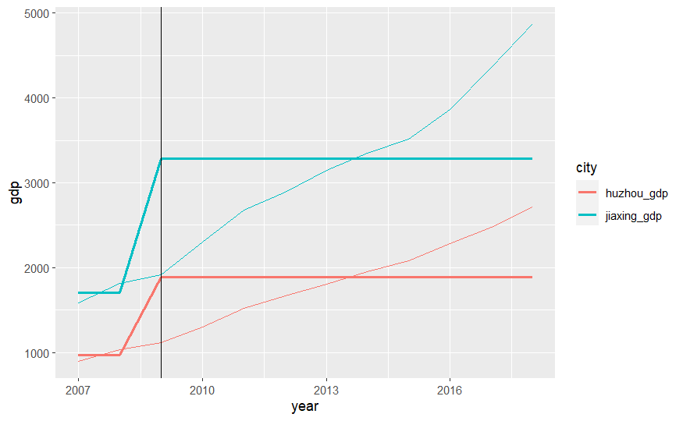
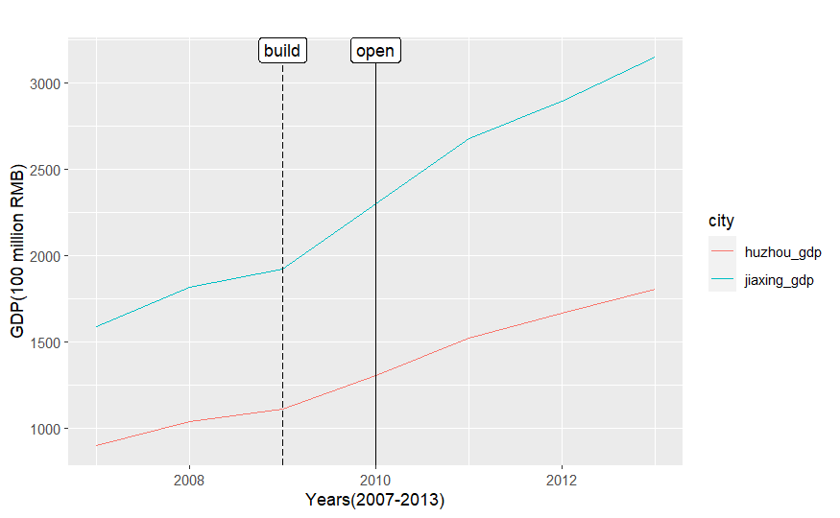
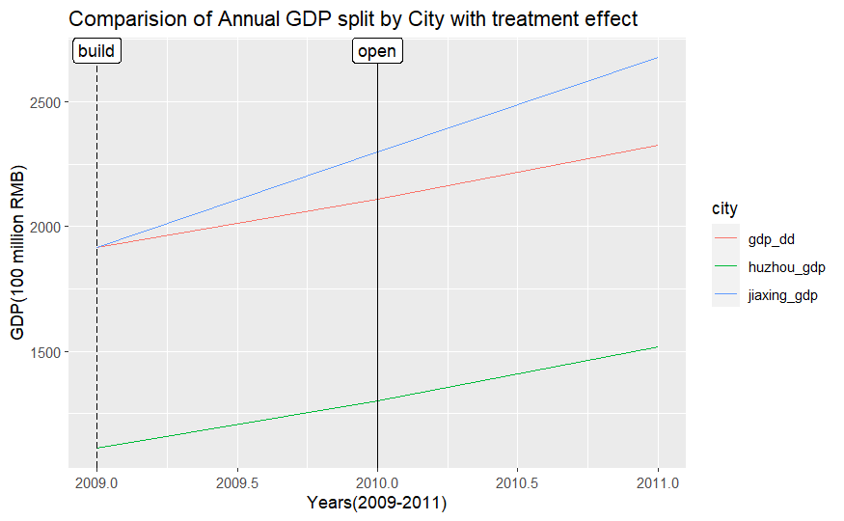
DID and Counterfactual

Slide 6
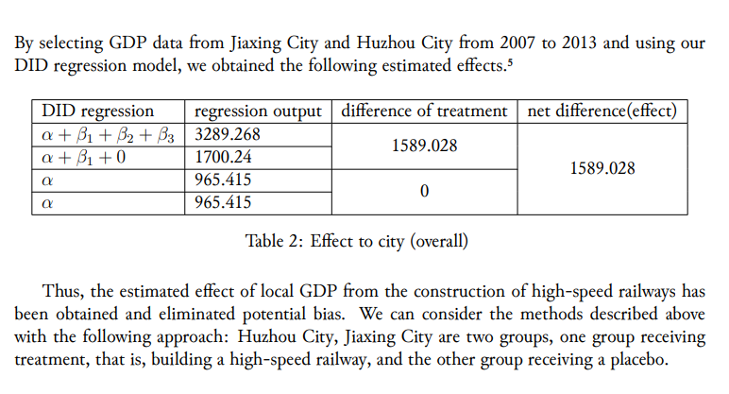

Slide 7
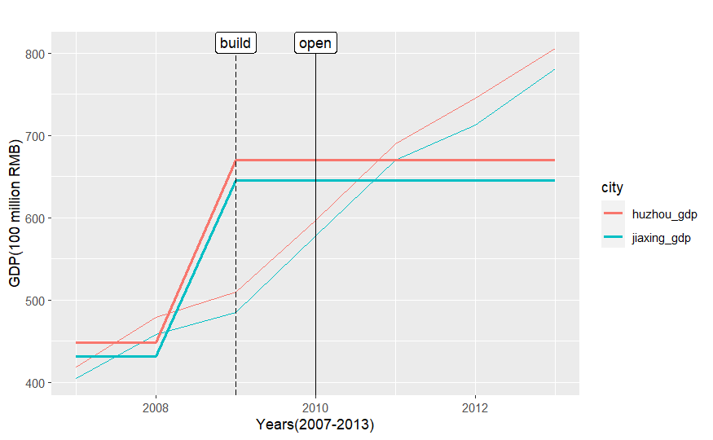
urban GDP of Jiaxing City and Huzhou City before and after the construction of high-speed rail
almost no impact on the GDP of the urban area from time series or fitted

Slide 8
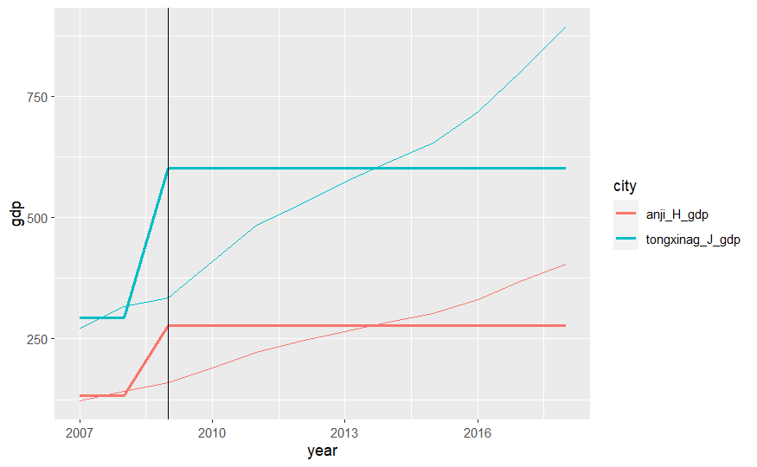
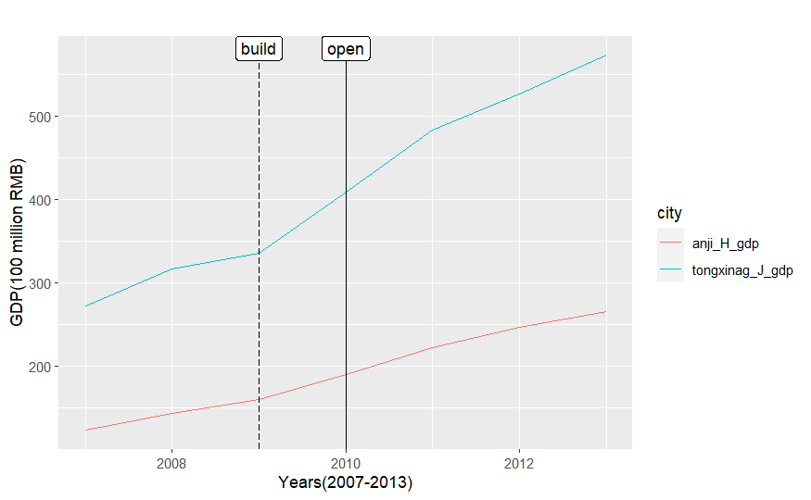
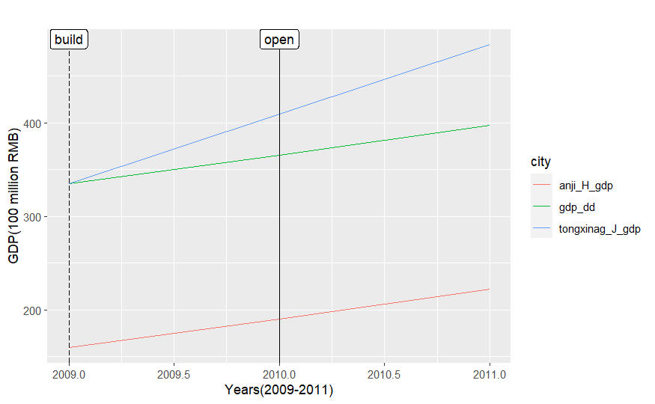
DID and Counterfactual

Slide 9
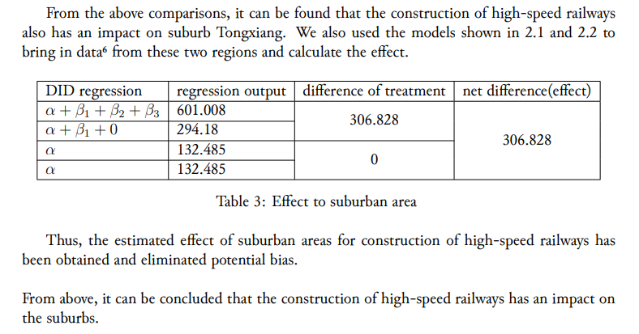

Slide 10
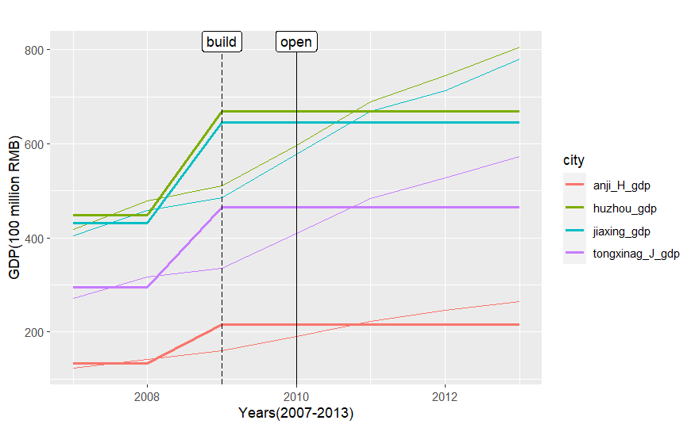
Fitted comparison of Annual GDP (urban vs suburban) (2007-2013)

Slide 11
Bias
s Jiaxing City, which is adjacent to the sea and has a port of Jiaxing, while Huzhou is located in the inland with part of mountainous areas in its suburbs.
Population
Labor
Investment
Personal income
Government revenue
Industry
………
More difficult to estimate using models, such as the abilities of the mayor and his team.

Slide 12
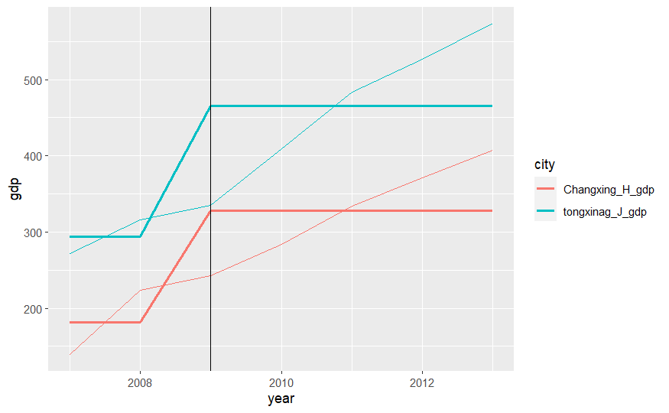
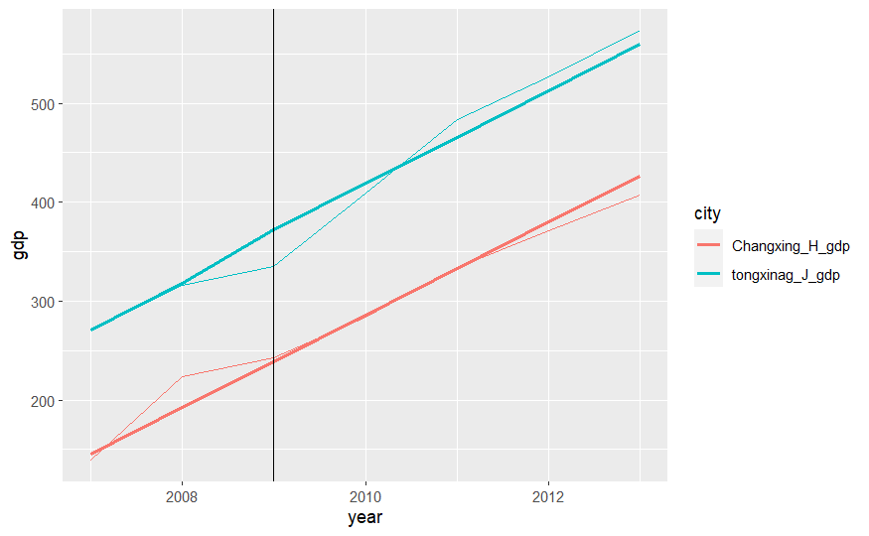
Bias
Changxing, another suburban area of Huzhou, to compare with Tongxiang. The two both started building high-speed railways in 2009, so there should not be a significant difference in GDP between the two before and after the construction of high-speed railways.

Slide 13
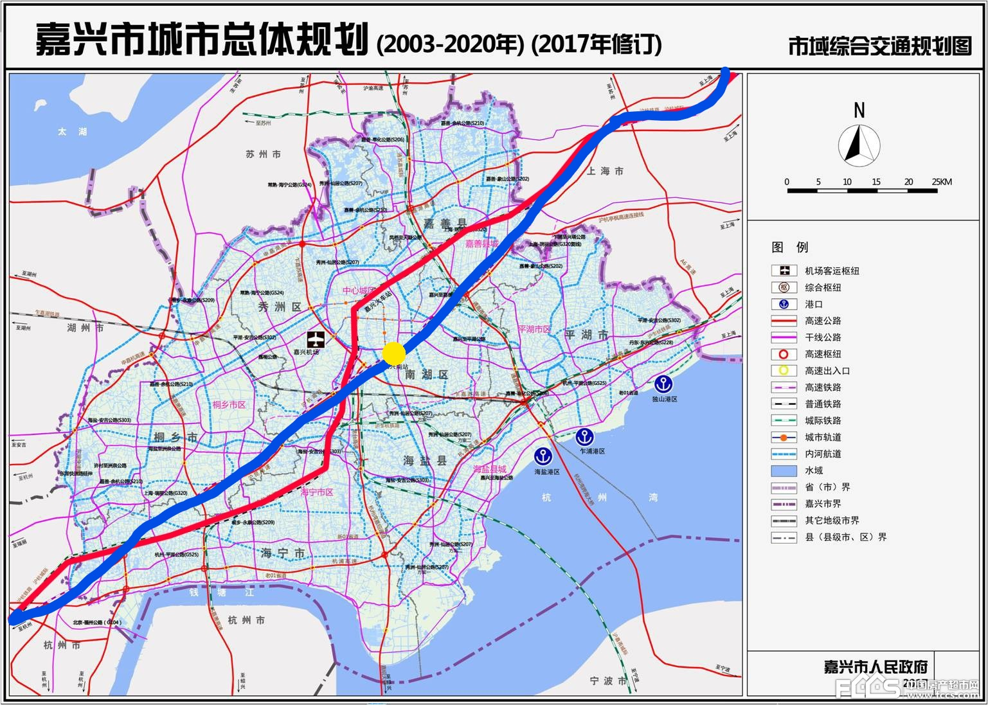
Conclusion
high-speed rail has a positive impact on local GDP, which can be demonstrated at both the city over all and suburban levels. Similarly, it was found that the construction of high-speed railways did not have a significant effect on the GDP of urban areas, but had on the suburbs.
high-speed trains along the boundaries of multiple suburban areas, and built the main high-speed railway station facing the urban population almost in the middle of two major urban areas but also close to suburbans
Reference:
City transportation planning (2003-2020), people’s government of Jiaxing City
嘉兴高铁图 - Bing images

